Slide 1
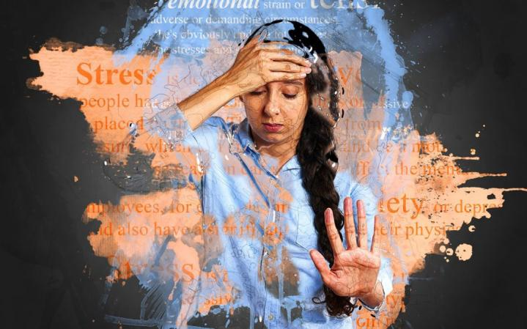
STRESS & ANXIETY Management

Slide 2
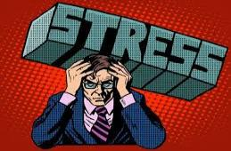
Reacting to stress …..
We all experience Stress in our lives: it’s normal
The trick is learning how we manage
Not everyone has same reaction to stress, your ability to deal with it can mean the difference between success and failure

Slide 3
What is Stress.?
Stress is what you feel when you are worried or uncomfortable about something. This worry in your mind can make your body feel bad and uncomfortable, you may feel angry, frustrated, scared, or afraid.
You may notice symptoms of stress when disciplining your kids, during busy times at work, when managing your finances, or when coping with a challenging relationship.
Stress is everywhere. And while a little stress is OK -- some stress is actually beneficial -- too much stress can wear you down and make you sick, both mentally and physically.

Slide 4

Stress at workplace…
Job stress can be defined as the harmful physical and emotional responses that occur when the requirements of the job do not match the capabilities, resources, or needs of the worker.
Job stress can lead to poor health and even injury.
Factors that commonly cause work-related stress includes-
Long hours.
Heavy workload.
Changes within the organisation.
Tight deadlines.
Changes to duties.
Job insecurity.
Lack of autonomy.

Slide 5

How stress affects your performance?
Low Productivity , poor quality of work.
Wrong Decision Making or Making bad decisions.
Decreased overall Performance.
Poor understanding with the manager, supervisor and subordinates.
Less concentration on work.

Slide 6
Recognize the warning signs…
Low energy, Headaches, Chest pain and increase in heart beat .
Depression or anxiety.
Anger, irritability, or restlessness.
Trouble sleeping or sleeping too much .
Upset stomach, Nausea.
Feeling overwhelmed, unmotivated, or unfocused.
Racing thoughts or constant worry.
Problems with your memory or concentration

Slide 7
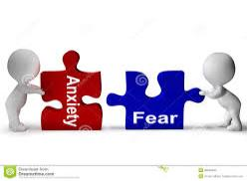
What is Anxiety?
Anxiety is the negative effect of stress.
Anxiety is distress or uneasiness of mind caused by a fear of danger or misfortune. Anxiety is a very common human emotion and is often associated with fear, panic, and the fight or flight response.
Recognize the warning sign…
Racing thoughts or negative thoughts, thinking too much.
Difficulties in concentrating on work, personal life
Feelings of dread, panic, sadness or upset
Getting irritated on small - small things.
Change in Appetite, Frequent colds and infections

Slide 8
Stress & Anxiety reducing practices you can do yourself….
Avoid Caffeine, Alcohol, and Nicotine. Avoid, or at least reduce.
Indulge in Physical Activity ( Walk ,Exercise, Swimming)
Get More Sleep
Try Relaxation Techniques ( Meditation, Yoga, laugh as much as you can)
Talk to Someone ( Manager, supervisor, colleague)
Eat a healthy diet
Take Rest if not feeling well, Spend time with friends and family and fun with them.
Manage Your Time for work and personal life.

Slide 9
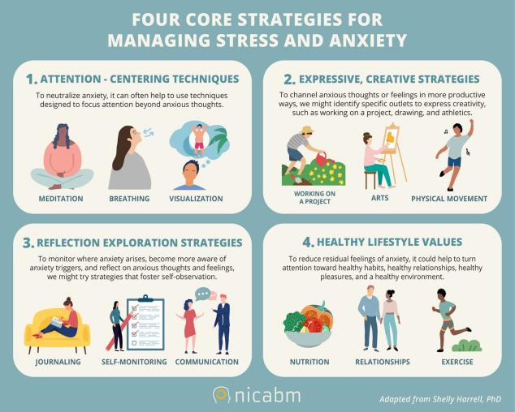

Slide 10
Thank You

